Slide 1
The Central Dogma of Molecular Biology

Slide 2
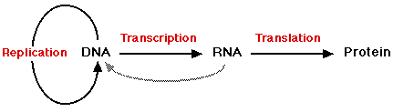
The Central Dogma of Molecular Biology
Reverse
Transcription

Slide 3
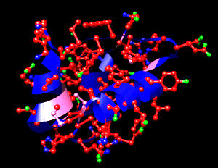
Importance of Proteins
There are three main kinds:
  structural - make up most body parts
  hormone - chemical that controls the body
  enzyme - catalyst - speeds up chemical reactions
Insulin,
a protein

Slide 4



Importance of Proteins
Without proteins there would be no life
All cells make proteins
Proteins in your body make up your:
  Hair
  Nails
  Muscles
  Skin
  Cartilage

Slide 5
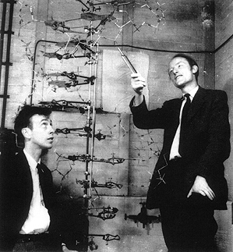
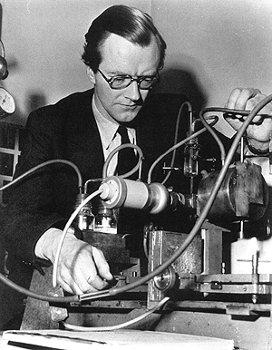
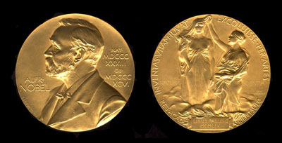
Discovery of DNA
(deoxyribonucleic acid)
1953 Watson, Crick and Wilkins determined the structure of DNA to be a double helix
They won a Nobel Prize for their work

Slide 6
DNA and RNA Compared
DNA
  Found only in nucleus*
  Double helix
  Bases = ATGC
  Sugar = Deoxyribose
RNA
  Found in ribosomes, nucleolus
  Single helix
  Bases = AUGC (URACIL)
  Sugar = Ribose
* DNA is also found in a select
number of other organelles

Slide 7
Introns and Exons
Introns – sequences in the DNA that are NOT used to make mRNA or to make a protein
Exons – sequences in the DNA that are expressed or used to make mRNA and ultimately are used to make a protein

Slide 8
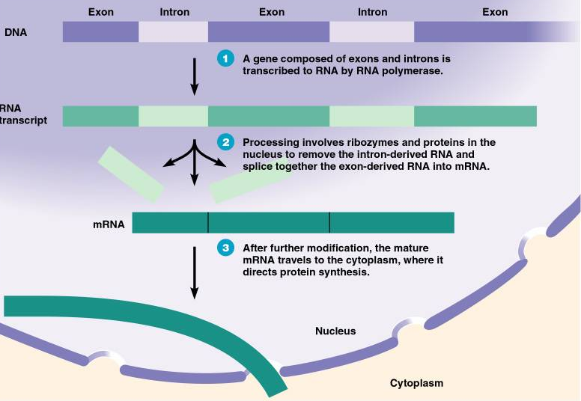
Introns and Exons

Slide 9
Ribonucleic Acid (RNA)
Three types of RNA:
  rRNA = ribosomal RNA - makes up the ribosome
  mRNA = messenger RNA - is the message from DNA for the construction of the new protein molecule
  tRNA = transfer RNA - carries amino acids to ribosomes

Slide 10
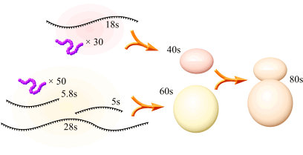
Ribonucleic Acid (RNA)
Ribosomal RNA is used to make a ribosome
The ribosome “reads” the mRNA plan for the new protein
Ribosome

Slide 11
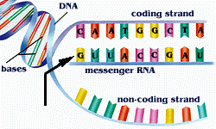
Ribonucleic Acid (RNA)
Messenger RNA
Sense
Antisense

Slide 12
Ribonucleic Acid (RNA)
Transfer RNA
  Each tRNA holds one amino acid
  Every tRNA has a special region called the
  anti-codon (3 bases)
  A tRNA anti-codon "mates" with codon on the mRNA molecule
  There are 61 different tRNA molecules, yet only about 20 amino acids

Slide 13
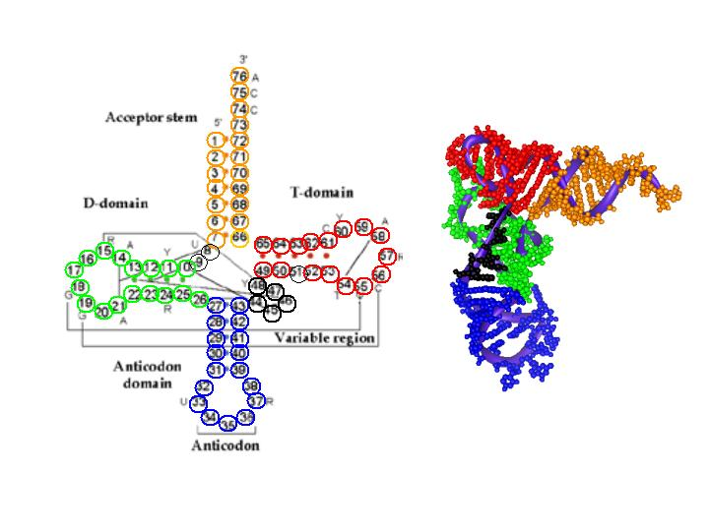
Ribonucleic Acid (RNA)
Transfer RNA

Slide 14
Transcription
Transcription is the special copying of one side of the DNA molecule (the sense strand) that results in a single strand of RNA
The original DNA is not changed
This process can be repeated
The amount of DNA that is transcribed is usually one gene

Slide 15
Transcription
Process of Transcription
  DNA is unzipped by an enzyme
  Only one side fills with RNA nucleotides by the action of another enzyme RNA polymerase
  A-U, G-C (NO THYMINE = T)
  As the RNA strand separates the DNA strands reattach as before the process started
  The result is the original DNA plus a new RNA strand

Slide 16
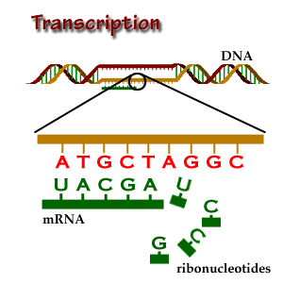
Transcription

Slide 17
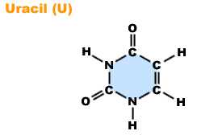
Transcription
Uracil – a base only found in RNA

Slide 18
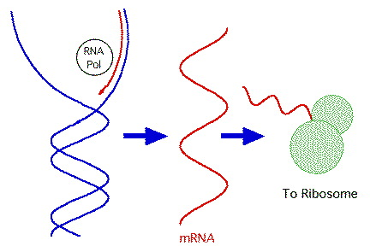
Transcription

Slide 19
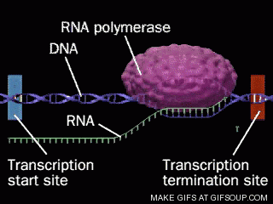
Transcription

Slide 20
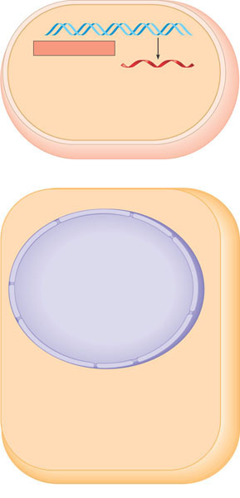
Overview: the roles of transcription and translation in the flow of genetic information (layer 1)
Prokaryotic cell. In a cell lacking a nucleus, mRNA
produced by transcription is immediately translated
without additional processing.
TRANSCRIPTION
DNA
Eukaryotic cell. The nucleus provides a separate
compartment for transcription. The original RNA
transcript, called pre-mRNA, is processed in various
ways before leaving the nucleus as mRNA.

Slide 21
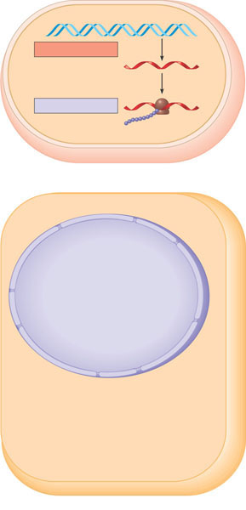
Overview: the roles of transcription and translation in the flow of genetic information (layer 2)
Prokaryotic cell. In a cell lacking a nucleus, mRNA
produced by transcription is immediately translated
without additional processing.
TRANSCRIPTION
DNA
mRNA
TRANSLATION
Ribosome
Polypeptide
Eukaryotic cell. The nucleus provides a separate
compartment for transcription. The original RNA
transcript, called pre-mRNA, is processed in various
ways before leaving the nucleus as mRNA.

Slide 22
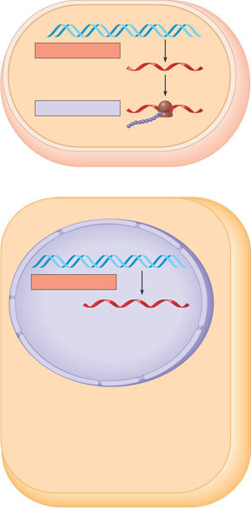
Overview: the roles of transcription and translation in the flow of genetic information (layer 3)
Prokaryotic cell. In a cell lacking a nucleus, mRNA
produced by transcription is immediately translated
without additional processing.
TRANSCRIPTION
DNA
mRNA
TRANSLATION
Ribosome
Polypeptide
Nuclear
envelope
Eukaryotic cell. The nucleus provides a separate
compartment for transcription. The original RNA
transcript, called pre-mRNA, is processed in various
ways before leaving the nucleus as mRNA.
TRANSCRIPTION
DNA

Slide 23
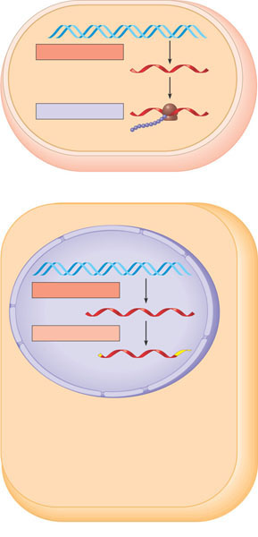
Overview: the roles of transcription and translation in the flow of genetic information (layer 4)
Prokaryotic cell. In a cell lacking a nucleus, mRNA
produced by transcription is immediately translated
without additional processing.
TRANSCRIPTION
DNA
mRNA
TRANSLATION
Ribosome
Polypeptide
Nuclear
envelope
Eukaryotic cell. The nucleus provides a separate
compartment for transcription. The original RNA
transcript, called pre-mRNA, is processed in various
ways before leaving the nucleus as mRNA.
TRANSCRIPTION
DNA
RNA PROCESSING
Pre-mRNA
mRNA

Slide 24
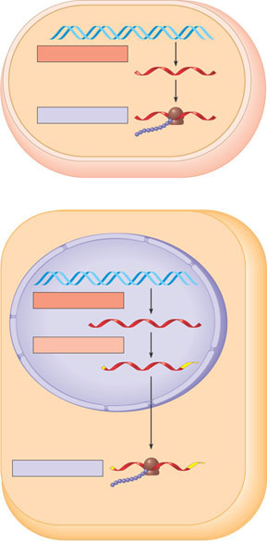
Overview: the roles of transcription and translation in the flow of genetic information (layer 5)
Prokaryotic cell. In a cell lacking a nucleus, mRNA
produced by transcription is immediately translated
without additional processing.
TRANSCRIPTION
DNA
mRNA
TRANSLATION
Ribosome
Polypeptide
Nuclear
envelope
Eukaryotic cell. The nucleus provides a separate
compartment for transcription. The original RNA
transcript, called pre-mRNA, is processed in various
ways before leaving the nucleus as mRNA.
TRANSCRIPTION
DNA
RNA PROCESSING
Pre-mRNA
mRNA
Ribosome
TRANSLATION
Polypeptide

Slide 25
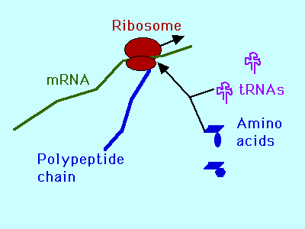
Translation
Translation is the reading of the RNA code to make proteins or polypeptides
Translation is often called protein synthesis

Slide 26
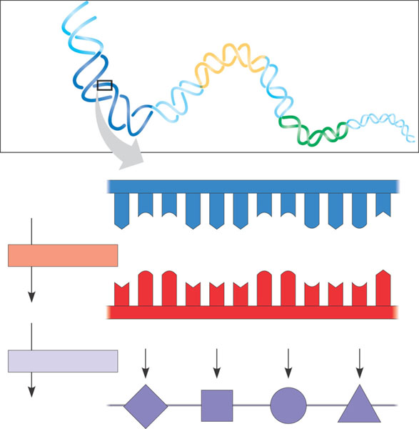
The triplet code
DNA
molecule
Gene 2
Gene 1
Gene 3
DNA strand
(template)
3′
5′
A
C
C
A
A
A
C
C
G
A
G
T
TRANSCRIPTION
U
G
G
U
U
U
G
G
C
U
C
A
mRNA
5′
3′
Codon
TRANSLATION
Protein
Trp
Phe
Gly
Ser
Amino acid

Slide 27
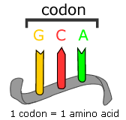
Translation
Triplet codons -groups of three bases on mRNA that code for specific amino acids

Slide 28
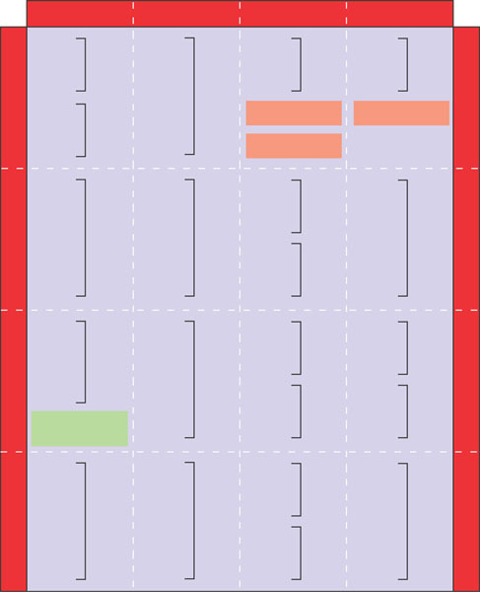
The dictionary of the genetic code
Second mRNA base
U
C
A
G
UUU
UCU
UAU
UGU
U
Phe
Tyr
Cys
U
UUC
UCC
UAC
UGC
C
UUA
UCA
Ser
UAA
Stop
UGA
Stop
A
UUG
Leu
UCG
UAG
Stop
UGG
Trp
G
CUU
CCU
CAU
CGU
U
His
CUC
CCC
CAC
CGC
C
C
Leu
Pro
Arg
CUA
CCA
CAA
CGA
A
Gln
CUG
CCG
CAG
CGG
G
First mRNA base (5′ end)
Third mRNA base (3′ end)
AUU
ACU
AAU
AGU
U
Asn
Ser
C
AUC
lle
ACC
AAC
AGC
A
Thr
AUA
ACA
AAA
AGA
A
Met or
start
Lys
Arg
G
AUG
ACG
AAG
AGG
GUU
GCU
GAU
GGU
U
GUC
GCC
GAC
Asp
GGC
C
G
Val
Ala
Gly
GUA
GCA
GAA
GGA
A
GUG
GCG
GAG
Glu
GGG
G

Slide 29
Translation
mRNA is the message (the plan for the protein)
rRNA "reads" the mRNA (the ribosome)
tRNA molecules carry amino acids to the ribosome for assembly into proteins
The ribosome allows only the correct tRNA to add its amino acid – others are rejected

Slide 30
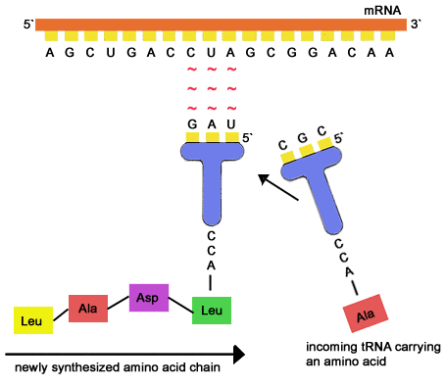
Translation

Slide 31
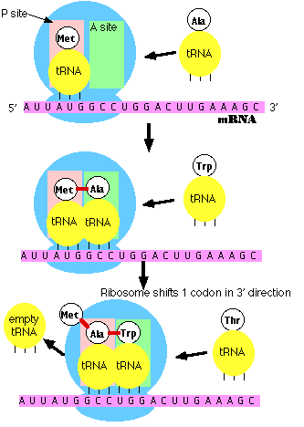
Translation

